Slide 1
COSMOS
SUPPLIES
Presenting for the Q-Guild and Members on 29th July 2020.

Slide 2
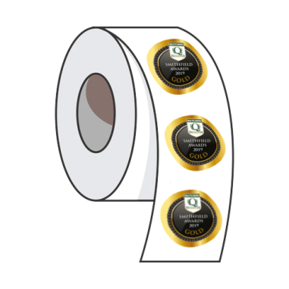
About Cosmos Supplies.
Labels.
Being responsible for the whole process, from design to print allows us the opportunity to be very competitive.
We guarantee to all members that we will beat any genuine price on a like for like bespoke label.
Aaron Barber joined Cosmos in 2016 and has over 11 years experience; predominantly working within the label industry.
2016 is the same year Cosmos became a Q-Guild corporate member and began supplying a number of members with bespoke scale labels.
We do however have 5 key sectors that make up our business:
Office Supplies.
We stock over 30,000 stationery lines – all available with free next day delivery, no minimum order value and a group discount for all members.
If preferred you can order online at anytime.
EOS – Electronic Office Supplies.
We have our own Cosmos branded toner cartridges that come with a lifetime guarantee that covers the printer as well as the cartridge!
They are around 25% cheaper than OEM & offer the same page yield per cartridge as well as free helpdesk support.
Labels.
Office
Supplies.
Print & Design.
PPE &
Facilities.
A complete print solution - We are also able to offer all types of bespoke print, Posters, Floor stickers, Letterheads, etc.
Our in-house design team can create anything you need.
EOS.
PPE & Facilities.
We have always supplied PPE and facilities supplies, due to COVID-19 we have seen a spike in PPE supplies, but we also stock cleaning and chemical solutions that are available on a free next day service.
Print & Design.

Slide 3
Not Broke, So why fix it?
We have found that the most common reason businesses don’t look at new label suppliers is because the process seems to be lengthy and painful and if anything goes wrong it will immediately impact the business.
We try and make the process as easy as possible:
Quote.
We need very little information to offer a quote – usually the type of printer and the size of your label is all we need.
Once quoted, internally we cover every detail, ensuring the adhesive and specification matches your current label.
Guaranteed Price Saving.
Compared to Bizerba we usually offer a minimum saving of 20% - In order to support all members we will price beat any genuine bespoke job, this way you know there’s a saving to be had before you start the process.
Turnaround & Aftercare.
Usually a printed job will be manufactured and delivered within 7-10 working days. If the job is urgent we can move things around & have stock to you within a couple of days.
Things can sometimes go wrong, but we have specialists who can work out the issues either remotely or on site so you won’t be left in the dark if you do require any assistance.

Slide 4
Our Customers
Here’s a list of some of the Q Guild
Members that we work with…
Testimonials
“Cosmos always ensure we have the best price point on our labels, we’ve seen our price improve over the years as appose to the usual incremental increases you see from other suppliers. The team always plan ahead to ensure we have our deliveries on time and when needed, we’ve not had any delivery issues in over 3 years.”
John Harding, Owton’s Traditional Family Butchers.
“We order printer cartridges for all our shops from Cosmos they provided a significant saving on the originals and we have never had any problems.
The service is fantastic and it’s great they can deliver direct to all our shops next day.”
Mary Craig, Cranstons Quality Butchers Limited.

Slide 5
Anything Else We Can Do To Help?
Contact Details:
Aaron Barber
Cosmos Supplies
5-11 Mercury Quays,
Saltaire, Bradford, BD17 7DB
01274 906 023
Aaron@cosmossupplies.com
We want to try and help, especially in this new age of uncertainty.
So, if anyone has any ideas please let us know and we will try to implement them for you and the other members.
Business Info:
Business Overview:
www.cosmossupplies.com
Labels:
www.cosmoslabels.com
PPE and Facilities:
www.cosmos-consumables.co.uk
Stationery Web Store:
store.cosmossupplies.com

